Slide 1





Wanna Be a Frac Sand Hauler?

Slide 2
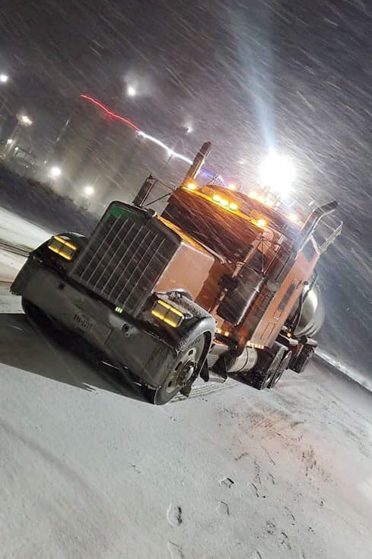

Driver Requirements

Slide 3
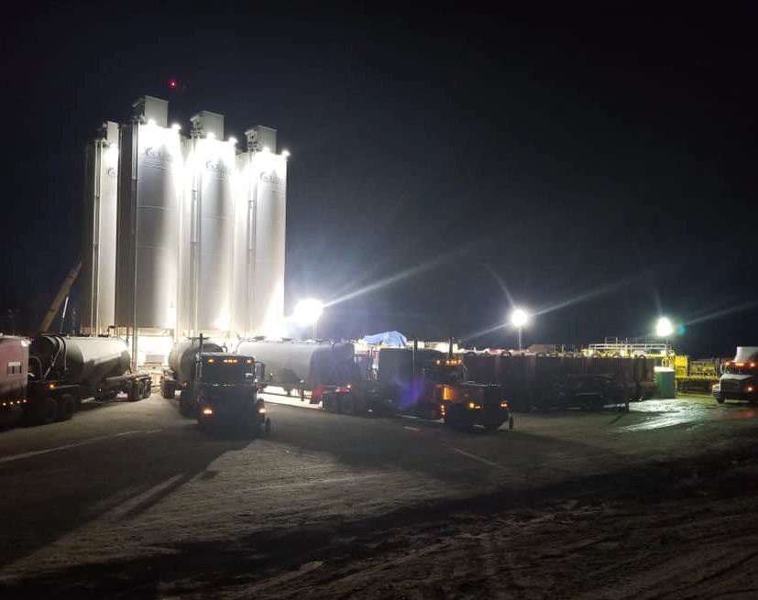
Safeland Training
The SafeLandUSA Training Course is designed to take the place of multiple operator orientations and to give each student a general idea of life and safety issues in the oil and gas industry and sets minimum requirements for the US Onshore E&P Industry. The course usually takes 7 – 8 hours to complete. The average cost for the course is
$200 and never expires. You can google Safeland Training to find out more information. Courses can be taken online or in a classroom setting according to personal preference.
There are many providers such as PEC or Rig Pass. Any of them are acceptable.

Slide 4














H2S (Hydrogen Sulfide) Training

Slide 5
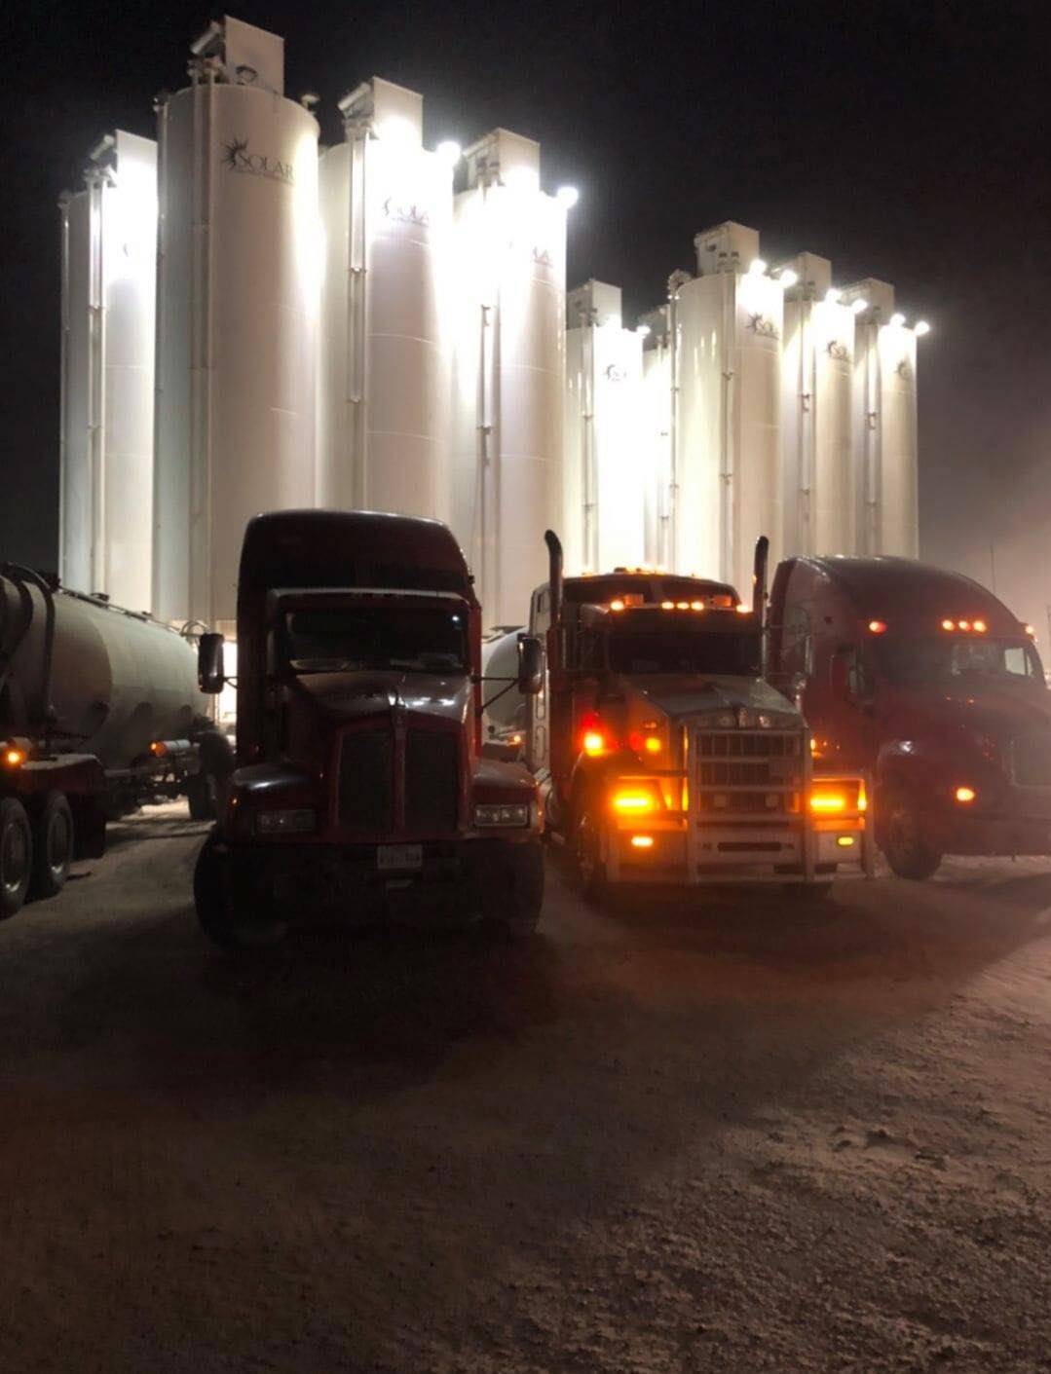












Respiratory Fit Test Certification

Slide 6

Med Card For CDL Holders
All commercial drivers of vehicles in interstate commerce with a maximum gross vehicle weight rating of over 10,000 pounds (4,536 kilograms) are required to obtain and maintain a valid Medical Examiner's Certificate (ME Certificate) Commercial drivers who drive vehicles requiring a CDL have two additional requirements. On or before January 30, 2014, all CDL holders must declare to their State Driver Licensing Agency (SDLA) that they only operate or expect to operate commercially in 1 of 4 possible categories with their CDL. This process is called self-certification. For more information on the self- certification categories see the FMCSA website.
CDL holders must provide their SDLA with a copy of their ME Certificate. This information is only being added to the State driving records of CDL holders. CDL holders, who are found driving in a category other than one to which they self-certified, are subject to suspension or revocation of their commercial driving privileges. CDL drivers, who do not update the expiration date of their ME Certificate with their State will have their commercial driving privileges downgraded and will not be eligible to drive a commercial motor vehicle that requires a CDL.

Slide 7







You got this…

Slide 8

Join the Pack Today!

